Slide 1
Asia Cup Stats Analysis
File created on: 9/19/2023 6:11:02 AM

Slide 2
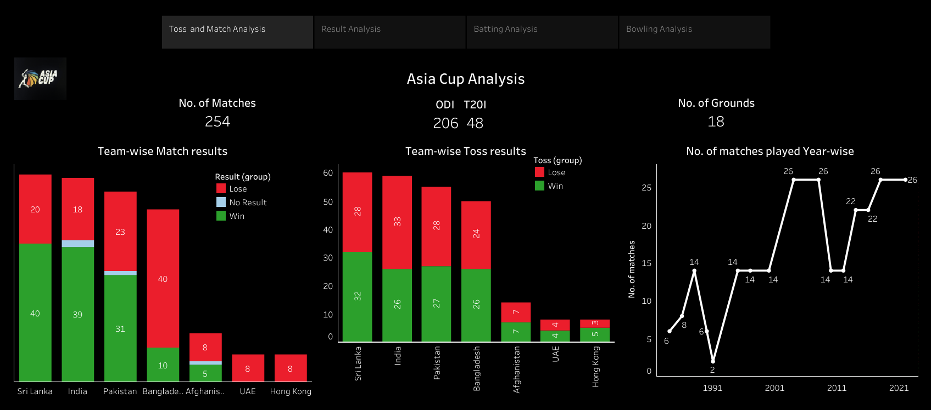

Slide 3
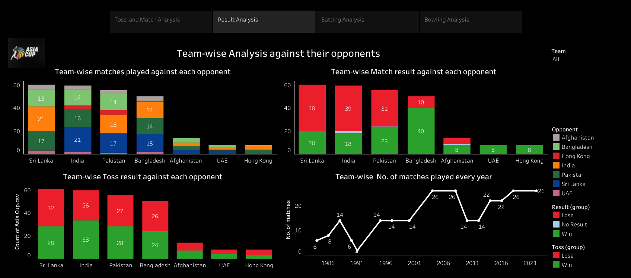

Slide 4
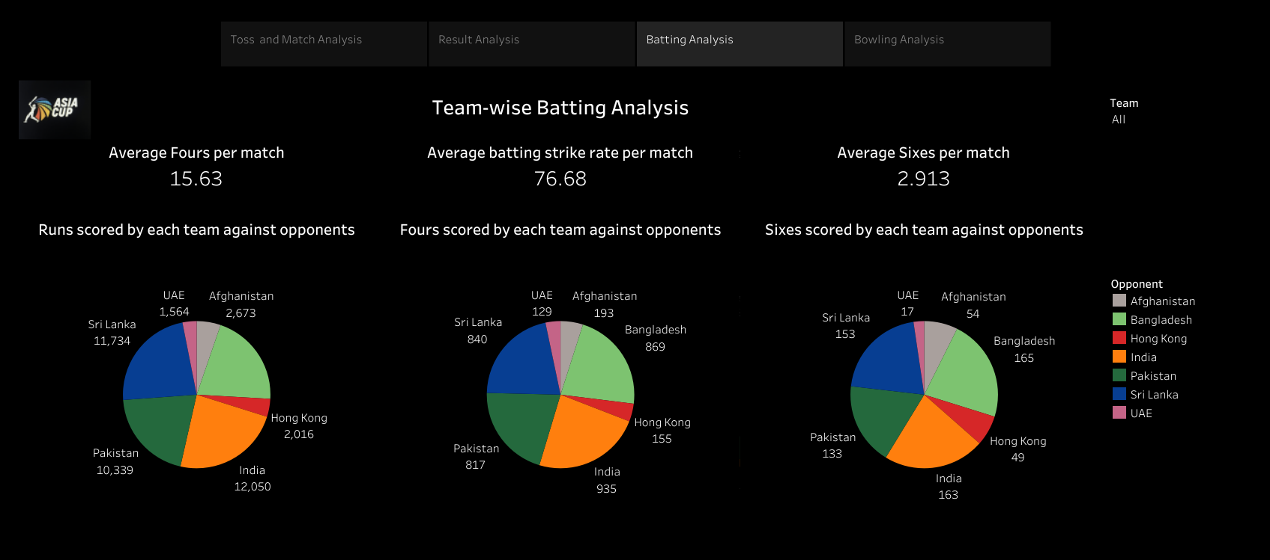

Slide 5
